Slide 1
Assignment 1 Case Study
Continental Airlines Fly high with Real Time Business Intelligence.

Slide 2
Overview
Continental Airlines found in 1934 took a leap from –
  “Worst to First” that shook the country
  Reinvent with raising the Bar from “First to Favourite”
Airline in Trouble
  Information Wasn’t Available
  lacked the corporate data infrastructure
Reason for success –
  Built in-house real time Data warehousing & Business Intelligence(BI) Tools
  Aggressive Go Forward Plan helped to achieve business excellence
  A re-energized workforce
  Synergies between decision support and operations
  changed business processes that utilize real-time data.
USA’s fifth largest airline and the seventh largest in the world

Slide 3
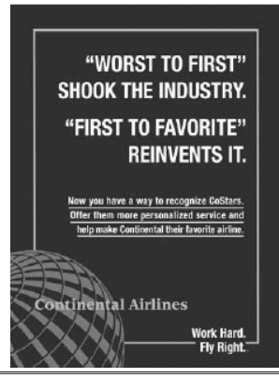
Key Concept - How Continental moved to Real Time BI application?
In 1994, Gordon Bethune presented a Go Forward plan having 4 interrelated parts-
  Fly to Win
  Fund the Future
  Make Reliability a Reality
  Working Together
Development of an enterprise data warehouse.
Make Reliability a Reality
Working Together - Continental Airline Internal Communications Poster
Three Initial Datawarehouse application
  Demand-driven Dispatch
  Goodwill Letters
  Group snoop

Slide 4
Using Enterprise-DW + Decision Support System
REAL-TIME BI APPLICATIONS
  Fare Design
  Recovering Lost Airline Reservations
  Customer Value Analysis
  Marketing Insight
  Flight Management Dashboard
  Fraud Investigations
  Is it Safe to Fly

Slide 5
SUPPORTING FIRST TO FAVORITE WITH TECHNOLOGY
  The Data Warehouse
  Data Access
  Real-time Data Sources
  The Data Warehouse Team
  Data Warehouse Governance
  Securing Funding
Concourse Display of High-Value Customer Activity
Display of Flight Lateness From/To Hubs

Slide 6
Benefits from Real-time BI and inhouse Data Warehousing
Marketing
Corporate Security
IT
Revenue Management

